Slide 1
307CR Aspects of Pervasive Computing

Slide 2
Summary
What is required for a system to be "Pervasive"
Key Areas
Aspects of pervasive technology

Slide 3
Pervasive Systems
Almost pervasive systems monitor some phenomena
Require some way of detecting this phenomena
Need a way to process and communicate data
Many pervasive systems allow user interaction.

Slide 4
Characteristics of Pervasive system
Many are Battery Powered
Need to consider network lifetime
Sensing
Processing
Communications

Slide 5
Monitoring a Phenomena
By this we mean something, often physical in nature that can be monitored.
We also need to know WHY we are monitoring this
The physical characteristics are also important
Is it physical, can it be seen / heard.

Slide 6
Example: Building Monitoring System
What are we wanting to measure?
Why do we measure it?
What are its characteristics?

Slide 7
Example: Building Monitoring System
What are we wanting to measure? 
Temperature (Room / External), Heating System Status
Why do we measure it?
To help make decisions on heating / cooling
What are its characteristics?
Physical (Temperature), Gas Use (Heating)

Slide 8
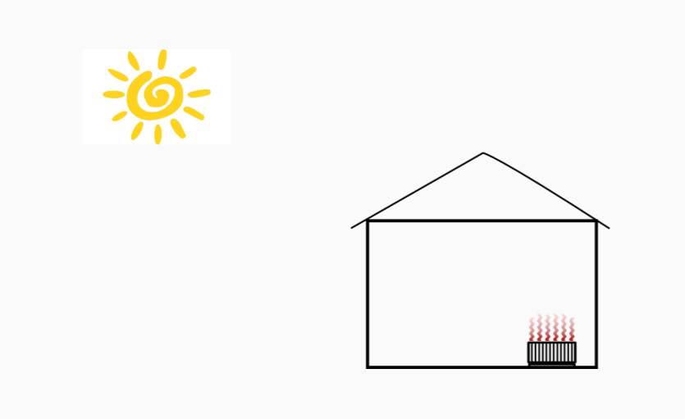
Example:

Slide 9
Method of Detecting / Sensing
There are a wide range of sensors that can be incorporated into a pervasive system 
(To be covered in another lecture)
Think about the data you are collecting and select the most appropriate device
Where in the system does this go? How does it work?

Slide 10
Example Building Monitoring System
In our above example we can use a temperature sensor
Thermistor (changes resistance based on temp)
MEMS based sensor

Slide 11
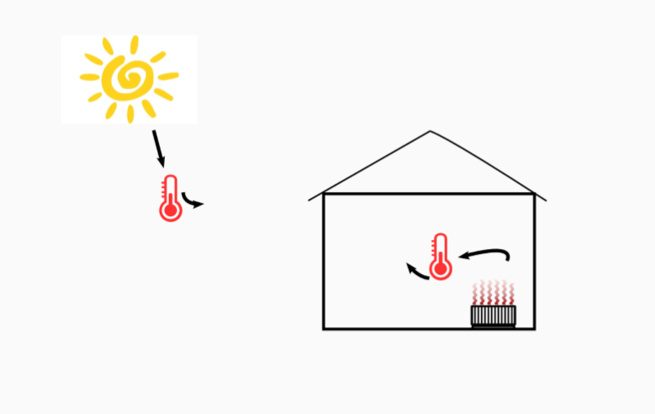
Example:

Slide 12
Processing Data
We shouldn't be collecting data for the hell of it.
Pervasive systems help us to make decisions based on the data. 
Transform from Data to User Relevant Information

Slide 13
Processing Data
Can be Done In-Network
On the sensing devices themselves
At the Sink
Data collected from all devices in a central place

Slide 14
Processing Data
In network processing tends to make use of Microprocessors
Low energy consumption
Becoming increasingly powerful whilst shrinking in size
Similar to a desktop style processor, only smaller
Many types of microprocessor available.

Slide 15
Question
What are the advantages and disadvantages of in-network processing?
What limitations may you experience when using a microprocessor, rather than a desktop processor.

Slide 16
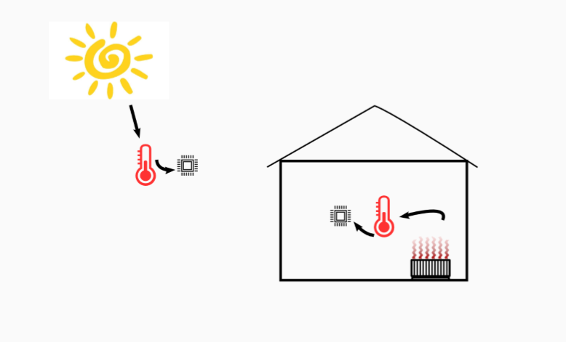
Example:

Slide 17
Communication
Often the purpose of the pervasive system will be to monitor and send details back to a user
There are numerous methods of communication available:
Bluetooth, WiFi , Sneakernet
The microprocessor will interact with the comms hardware and send relevant data to the user

Slide 18
Communications Trade ofs
Sending data is usually the most expensive part of sensor network operation
Trade of between Range, Bandwidth and Network Lifetime

Slide 19
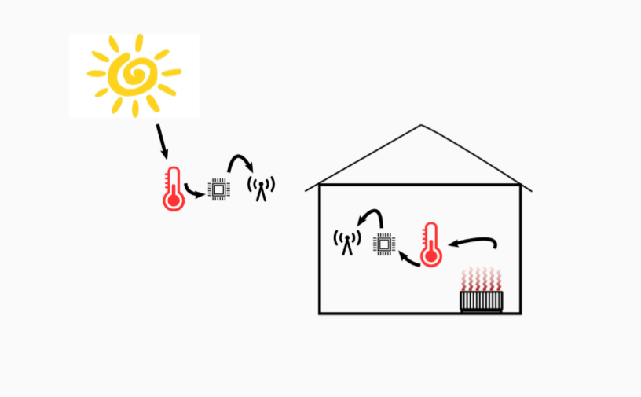
Example

Slide 20
Storage and Display
Finally Data is usually sent to a sink
Central Repository for the data
More processing can take place
User interface to display data

Slide 21
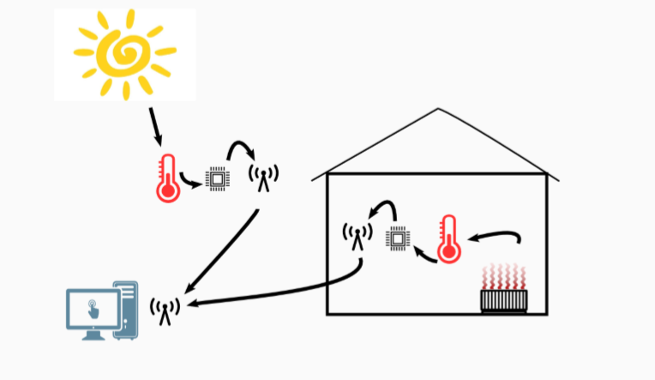
Example

Slide 22
Key Areas
The majority of pervasive systems fall into one of the following categories.
Wearable Computing
Wireless Sensor Networks
Context Aware Systems
Augmented Reality.

Slide 23
Wearable Computing
A computer powered device that can be worn by the user
Includes Clothes, accessories, bags etc.
Wearable systems are often referred to as "smart" (IE Smart Watch, Smart Shoes)
A Popular theme at the moment

Slide 24
Question / Discussion
What are the potential limitations of wearable systems?

Slide 25
Wireless Sensor Networks
Based on distributed sensors feeding information back to a user
Refers to the topology of a system, and can be used in conjunction with other systems (for example context aware, wearable)
May include thousands of individual sensors
Effective for collecting large amounts of data.

Slide 26
Question / Discussion
We want to create a WSN based system to map the current strength and temperature data of water on the great barrier reef. How is this possible?

Slide 27
Context Aware Systems
Refers to a system that is monitoring pre-dened parameters for change
Can be create to alert a user of change, of activate pre selected systems to adjust to the phenomena
Can be used in conjunction with wearable systems or WSN
Effective for monitoring and maintaining certain environmental parameters.

Slide 28
Question / Discussion
How can a context aware system be applied to the growth of strawberries in order to ensure a higher quality product can be produced for more months of the year?

Slide 29
Augmented Reality
Focus on blending the real world with the digital world
Require some way of displaying information in the real world (projector, glasses)
Pretty awesome way of showing the data from a sensor network.

Slide 30
Questions / Discussion
How do augmented reality systems dier from Virtual Reality systems (such as the Rift)

